Slide 1
Reactome pathway knowledgebase Connecting pathways, networks, and disease
Robin Haw, PhD Project Manager and Outreach Coordinator
Ontario Institute for Cancer Research robin.haw@oicr.on.ca San Diego. March 15, 2016
Notes:
I’d like to talk about Reactome as a source of framework information for genomics data analysis

Slide 2
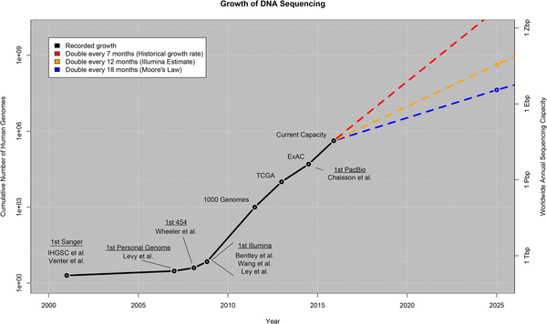

BIG data & Genomics
Stephens ZD, Lee SY, Faghri F, Campbell RH, Zhai C, et al. (2015) Big Data: Astronomical or Genomical?. PLoS Biol 13(7): e1002195. doi:10.1371/journal.pbio.1002195
http://journals.plos.org/plosbiology/article?id=info:doi/10.1371/journal.pbio.1002195
Notes:
Our understanding of the molecular mechanisms of human disease has benefited from the advent of high-throughput techniques that generate vast quantities of genomic, expression and variant data.
As you can see from this graph, we are projected to be generate a lot more data.
Biological pathway databases play a key role in organizing and interpreting genomic data by capturing what is already known about the interplay of genes, proteins and small molecules in a data model that is accessible to computation.

Slide 3
Motivation for Pathway Databases and Analysis
Intuitive display for biological and chemical data.
Visualize multiple data types on a pathway.
Computational methods available to automate analysis.
Pathway Databases satisfy common “use cases”:
Identifying hidden patterns in gene lists.
Creating mechanistic models to explain experimental observations.
Predicting the function of unannotated genes.
Establishing the framework for quantitative modeling.
Assisting in the development of molecular signatures.
Notes:
Talk about the motivation

Slide 4
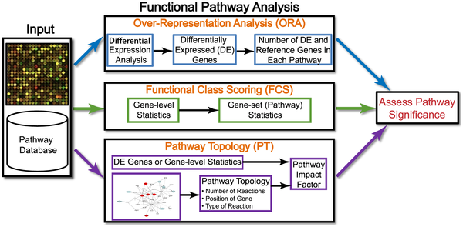
Pathway Analysis Pipeline
Khatri et al. PLOS Comp Bio. 8:1 2012
Notes:
This overview demonsstrates a typical pathway analysis pipeline for genomic data.
The data generated by an experiment along with the pathway annotations of the corresponding genome, are input to virtually all pathway analysis methods.
ORA methods require that the input is a list of differentially expressed genes,
FCS methods use the entire data matrix as input.
PT-based methods utilize the number and type of interactions between gene products, which may or may not be a part of a pathway database.
The result of every pathway analysis method is a list of significant pathways in the condition under study.

Slide 5

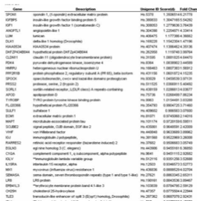
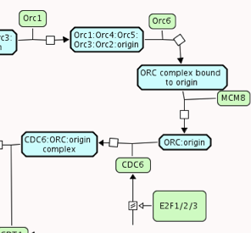
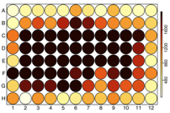
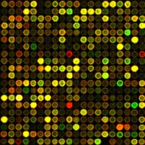
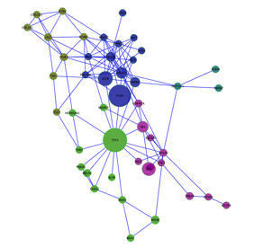
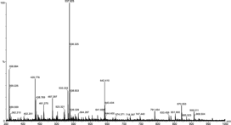
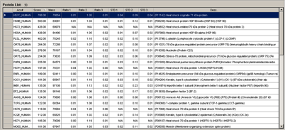
What is Reactome?
Open source and open access pathway database
1900+ pathway modules encompassing many areas of human biology.
Expert authored, manually curated and peer-reviewed.
Every pathway is traceable to primary literature.
Extensively cross-referenced to external bio- and chemoinformatics databases.
Computationally inferred pathways for 18 model organisms.
Provides tools and datasets for browsing and visualizing pathway data.
www.reactome.org
Notes:
Over the last 16 years that Reactome has been curating and exporting data, we’ve grown to include annotations for over half human protein-coding genes linked to over 1900 pathways.
Our curation system relies heavily on the expert knowledge of researchers within the community who collaborate with curators to assemble detailed machine-readable descriptions of human biological pathways based on evidence from primary research literature.
Currently there are over 21K+ literature references from PubMed and a handful of textbooks.
Extensive link outs to other biological and chemical databases.
Project human pathways into other M/O species.
Provide tools and datasets.

Slide 6
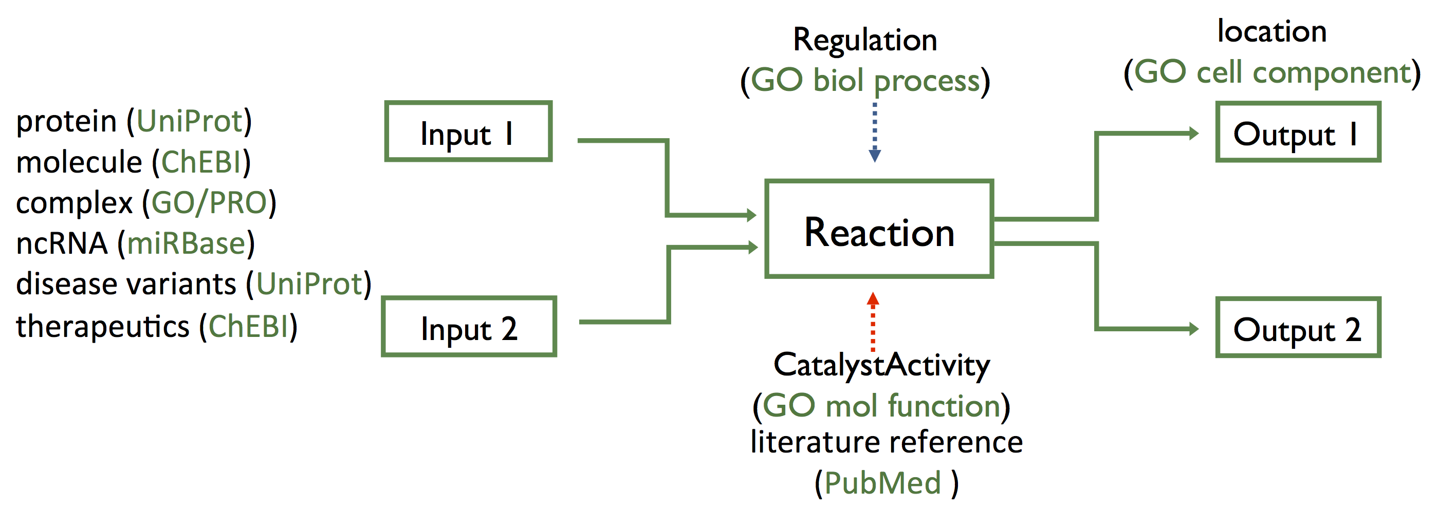
The Unit of Reactome
Reactome is a Reaction Network Database
explicitly describe biological processes as a series of biochemical reactions and events
represents many events and states found in biology.
Notes:
The unit of Reactome is the reaction where,
each node represents a biomolecule
each edge represents the conversion of one or more biomolecules into another via a reaction.
Biomolecules include proteins, nucleic acids, metabolites, small molecules. therapeutics, drugs and variants
We reference multiple entity databases to describe our biomolecules and Gene Ontology to explicitly describe key elements of the reaction.

Slide 7
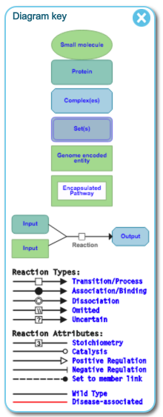
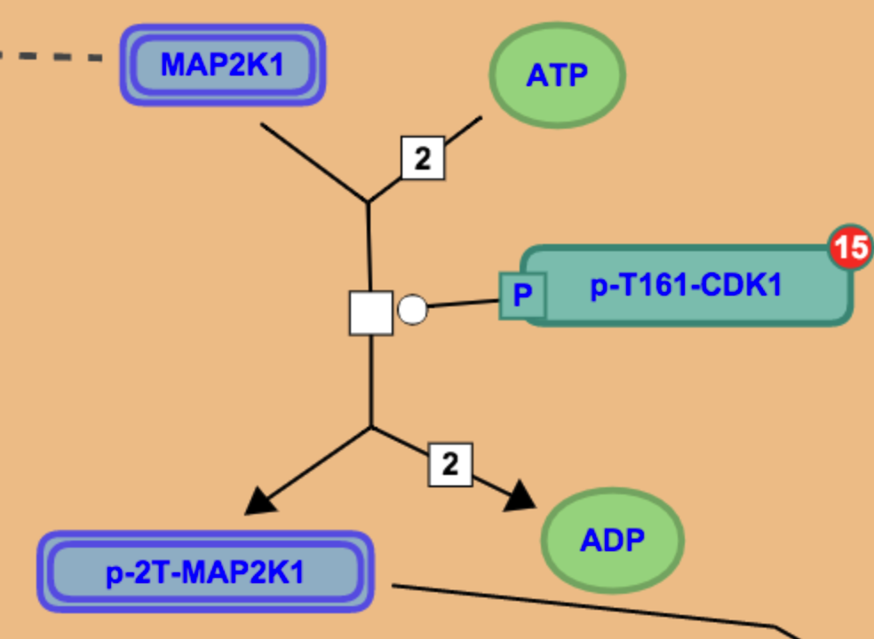
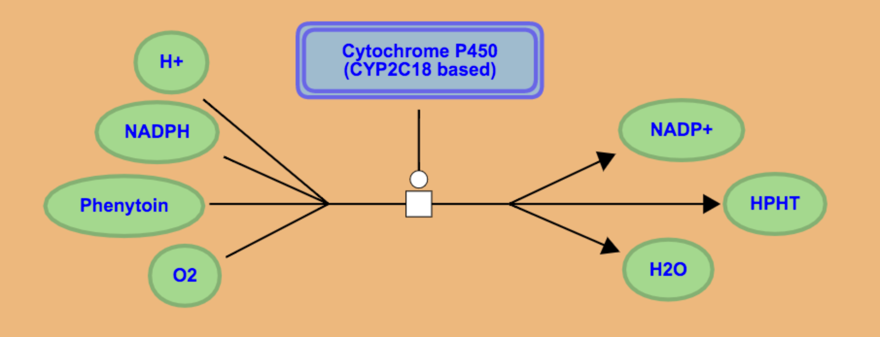
Reaction and Pathway Coverage
Phosphorylation
Metabolic
Metabolism (Anabolic, Catabolic, Xenobiotic, etc)
Signal Transduction (EGFR, Notch, Wnt, etc.)
Developmental Biology (Axon Guidance, Myogenesis)
Cell Cycle
DNA Damage & Repair
Stress Response
Disease (Metabolic Disorder, Cancer, etc)
Notes:
The flexibility of the reactome data model allows us to describe many different reaction types and pathways.
For example, pathways associated with metabolism, signaling, and biological processes and human disease.
To provide a standardized visual representation within our pathway diagrams, Reactome employs Systems Biology Graphical Notation (SBGN). We use the SBGN subtype called Process Diagram (PD) - represent mechanistic and temporal aspects of biological events. The Biomolecules have a particular shape and cellular localisation. Icons are used to describe the different molecule types, types of reactions.

Slide 8
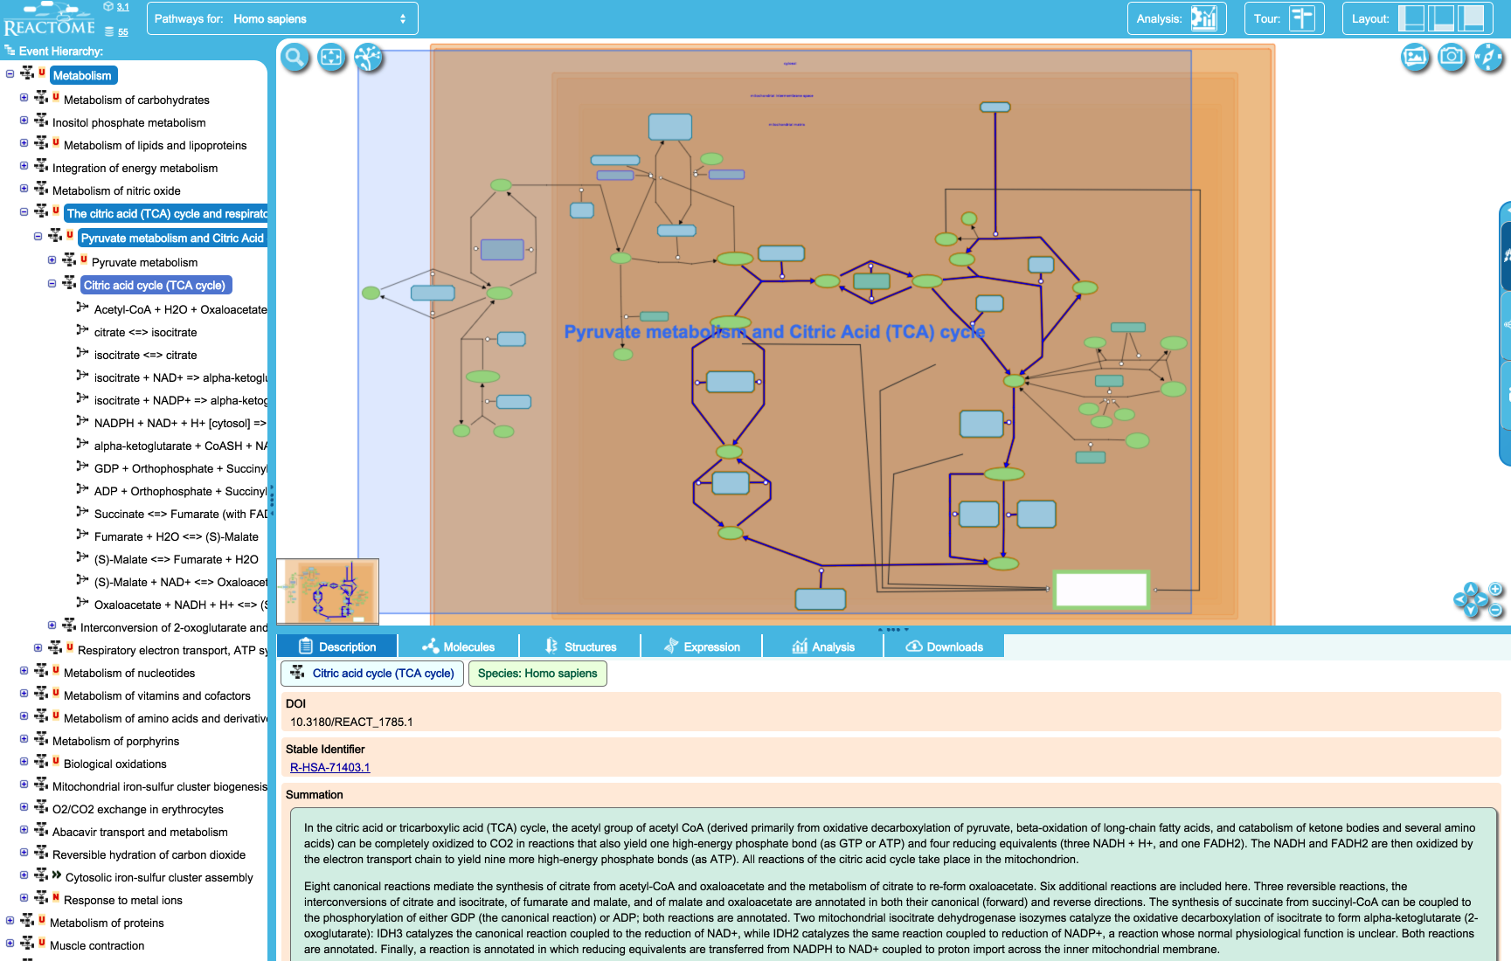
Pathway Browser
Notes:
To allow our users to explore our encyclopedia of pathways, we have the Pathway browser.
To the left is the Event Hierarchy which list all the pathways in Reactome. As you select a pathway, a diagram will appear to the right and details of the pathway, reactions and moelcules will appear in the tabbed panel below.
The diagram is like Google Maps, allowing you to interact with the pathway and reaction components, and display useful information.

Slide 9
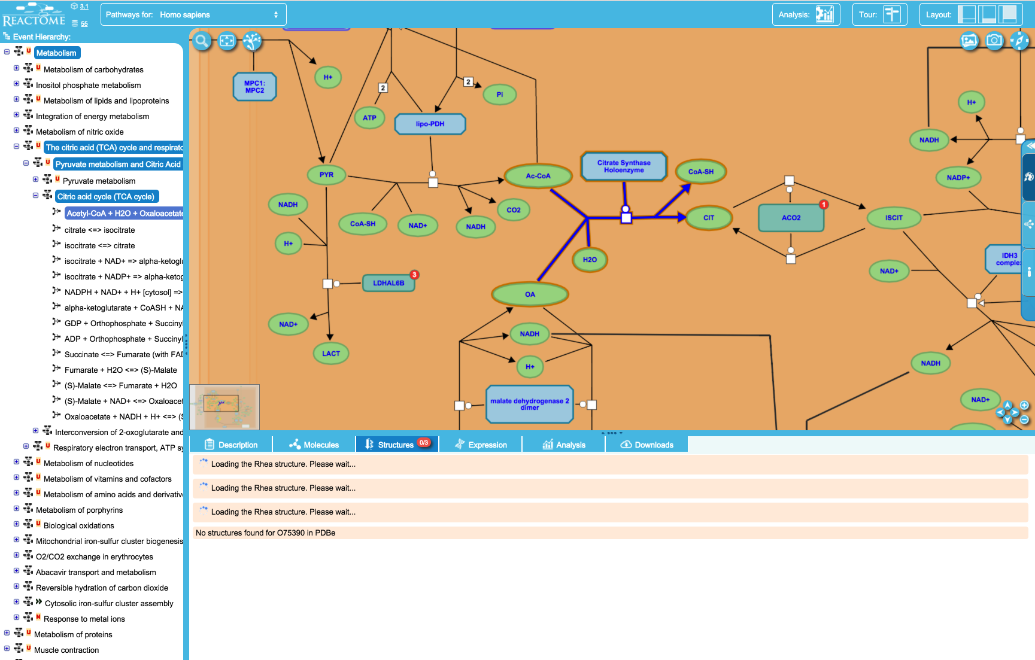
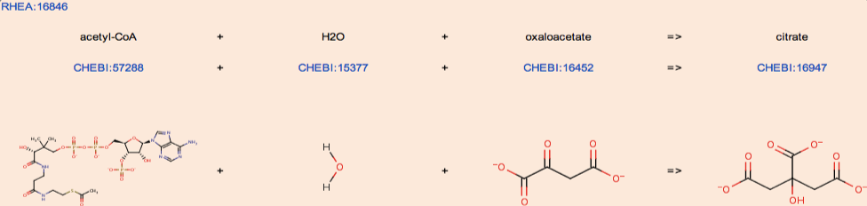
Balanced Reactions from Rhea
Notes:
We integrate context-sensitive information from other biological and chemical resources in the tabbed details panel, using widgets provided by the external resources.
This includes balanced chemical reactions from Rhea. A set of completely balanced reactions, is important to accurate modelling of metabolic networks and calculating metabolite fluxes in biological systems.

Slide 10
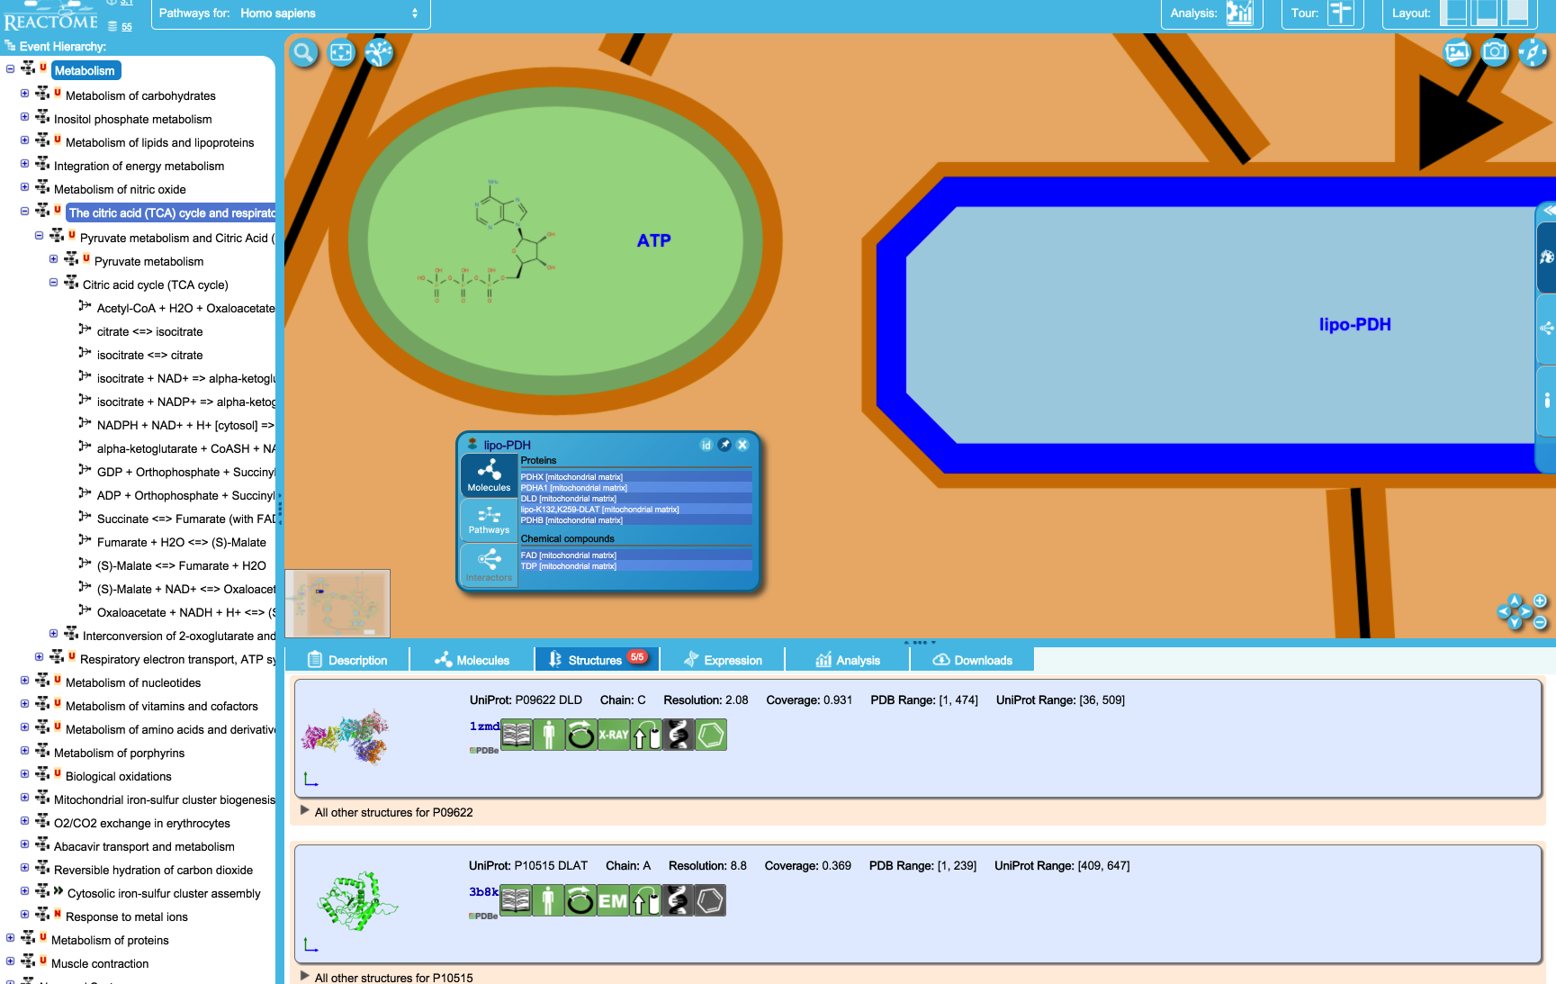
Protein and Chemical Structures
Notes:
To the left we are displaying chemical structure for ATP from ChEBI.
Selecting the Structures tab and zooming in over the complex pyruvate dehydrogenase in the pathway diagram will allow users to view the protein structural information from PDBe.
Clicking on the boxes links out to additional crystal structure details, citations and experimental methods at PDBe.
We can display other metabolite, small molecule, vaccine and therapeutic annotations and information from ChEBI and ZINC.

Slide 11
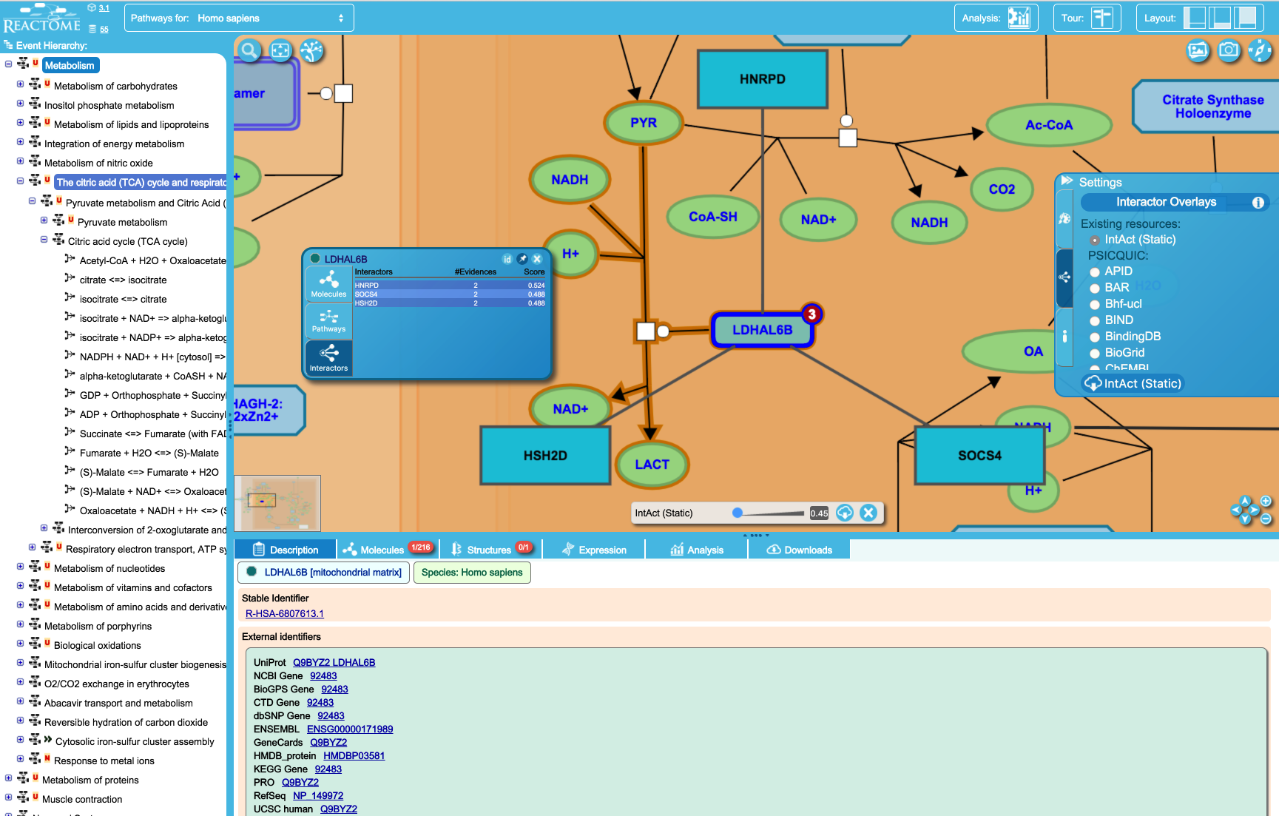
PSICQUIC Interaction Overlay
Notes:
We can increase our coverage of the genome by importing molecular interactions data.
PSICQUIC is a web service, which provides computational access to over 150M binary interactions, both PPI and PSMI, from over 30 databases. Reactome exploits the PSICQUIC web services to overlay molecular interaction data in the Pathway Browser. In the example, L-lactate dehydrogenase, we are displaying all protein interactions from IntAct. The nodes and edges of the overlay network are interactive providing access to UniProt information (for protein nodes) and IntAct records (for the interactions). It’s also possible to overlay small molecule interactions from ChEBI.

Slide 12
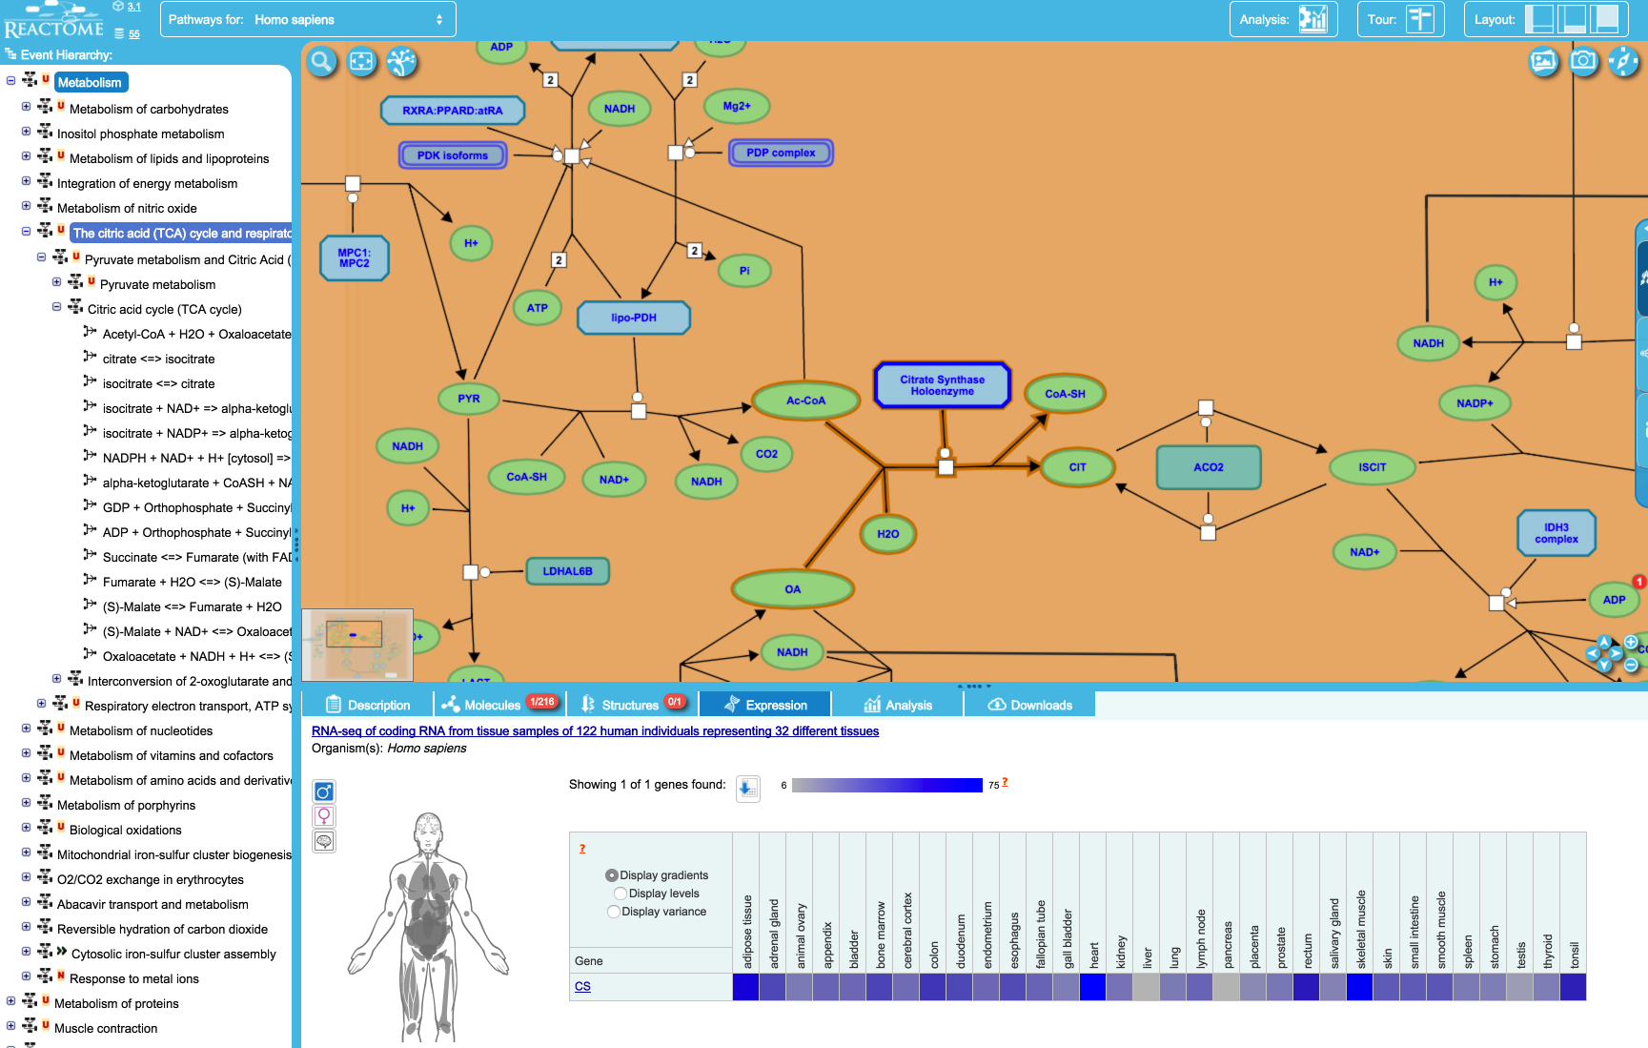
Expression Data from Gene Expression Atlas
Notes:
We can also display genomic expression data in the pathway context. A user will be able to see the Expression profiles from the Gene Expression Atlas for all protein participants in the reaction, or the selected entities. In this example, clicking citrate synthase holoenzyme, will display the tissues in which this gene is expressed.

Slide 13
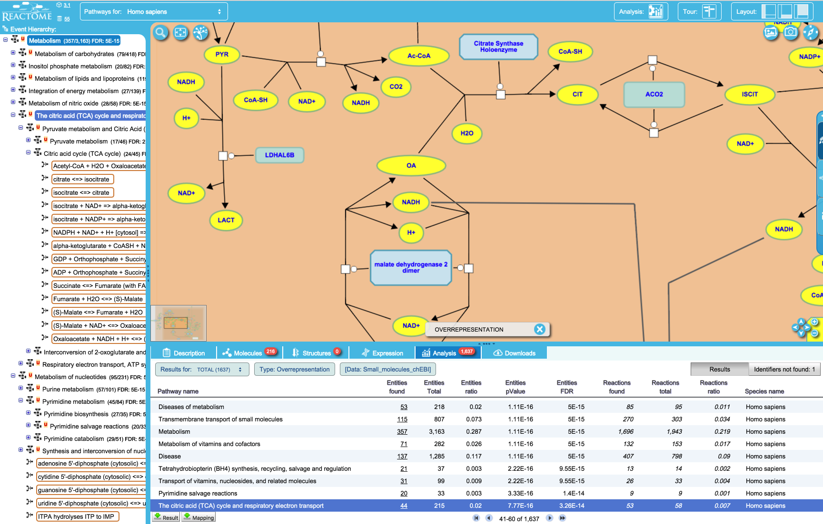
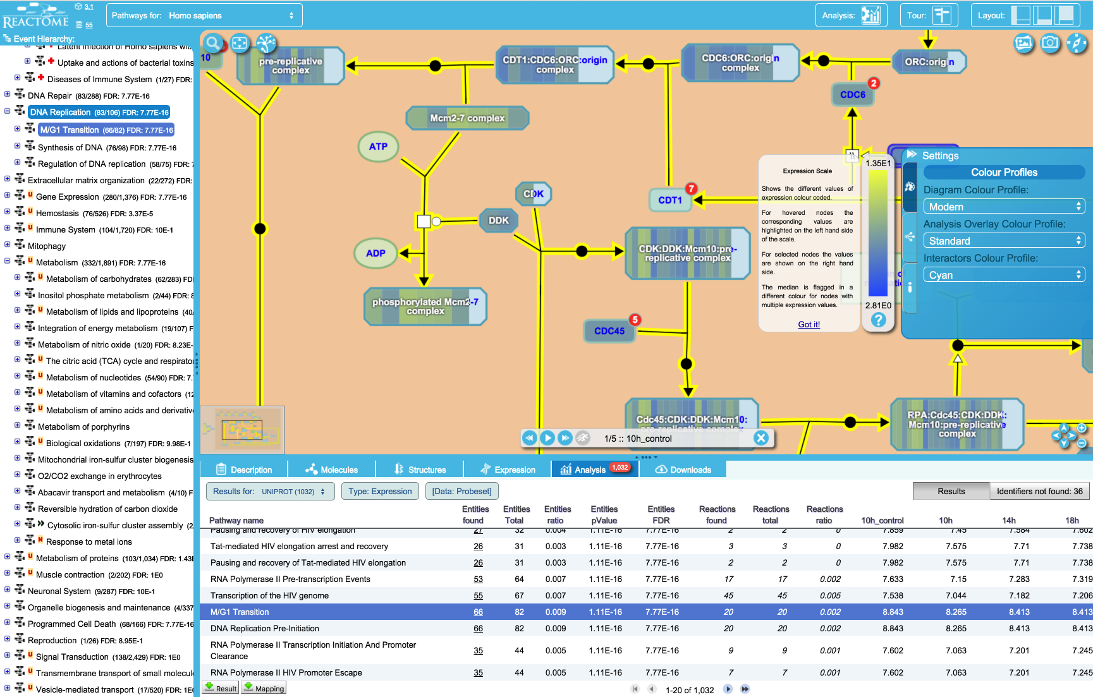
Pathway Diagrams support Reactome Tools
Pathway Mapping and Enrichment Analysis
What pathways are represented in my dataset?
Is my dataset enriched with proteins from a pathway?
Expression Overlay onto Pathways
Which pathways are expressed in my dataset?
Compare Species
What pathways are shared between humans and model organisms?
External Data Linkages (linkouts to ZINC & ChEMBL)
For each compound, is it commercially available or an analog is purchasable?
For each protein target, what compounds are known and purchasable?
Notes:
Not only does the pathway browser provides a framework for data integration and visualization but also data analysis.
Typically researchers will use these tools to
Analyze lists of gene, proteins or small molecules.
Colorize pathway diagrams with expression data.
Thorouh linkouts we can determine if compounds and their analogs are commercially available and determine on and off target effects.
This screenshot shows the results of the analysis of a list of small molecules. The yellow-highlighted nodes correspond to hits within the list of small molecules.
This second example shows the analysis of a genomics data set. The coloured bars represent the expression levels of the genes within the dataset.

Slide 14



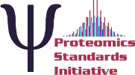

Interoperability through Open Data Standards
Standard graphical languages for representing biological processes and interactions
BioPAX
SBML level 2.4
Open access interchange format for computer models of biochemical pathways, reactions and networks.
BioPAX level 2 & 3.
Standard language that aims to enable integration, exchange, visualization and analysis of biological pathway data.
PSICQUIC is an effort to standardize the access to molecular interaction databases.
PSI-MITAB is the data exchange format.
Notes:
For the power users who may not necessarily want to use Reactome tools, they can instead download pathway and interaction data using different data standards.
I’ve already introduced you to SBGN and PSICQUIC. The last two standards that Reactome supports that play a piviotal role in data exchange and intergration with respect to systems biology are:
SBML – representing models of biochemical pathways, reactions and networks.
BioPAX – used for representing pathway and network data.
We also provide RESTful data webservices, which support computational access to Reactome data and software that I have just described.

Slide 15
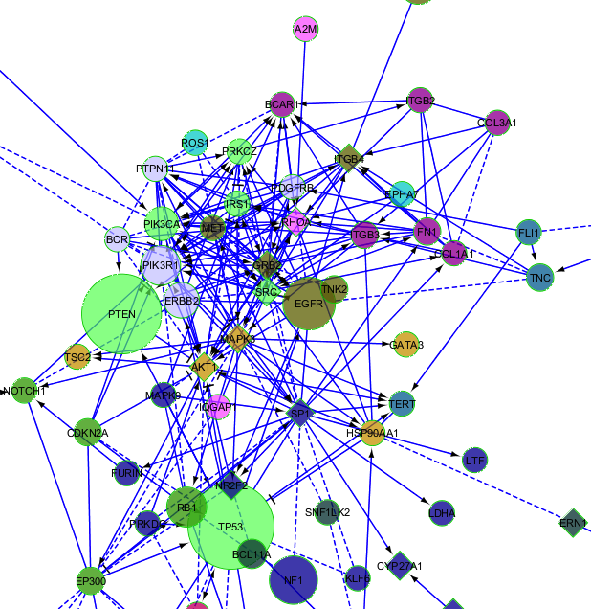
Network Module-based Analysis of Disease OMICS data
Analyzing mutated genes in a network context:
reveals relationships among these genes
can elucidate mechanism of action of drivers
facilitates hypothesis generation on roles of these genes in disease phenotype
Network analysis reduces hundreds of mutated genes to < dozen mutated pathways
Notes:
Now I want to shift to the next generation of data analysis tools that Reactome is developing around this Network Module Based approach to analyze next generation sequencing datasets. Particularly datasets that generate large list of genes, expression or variant data.

Slide 16

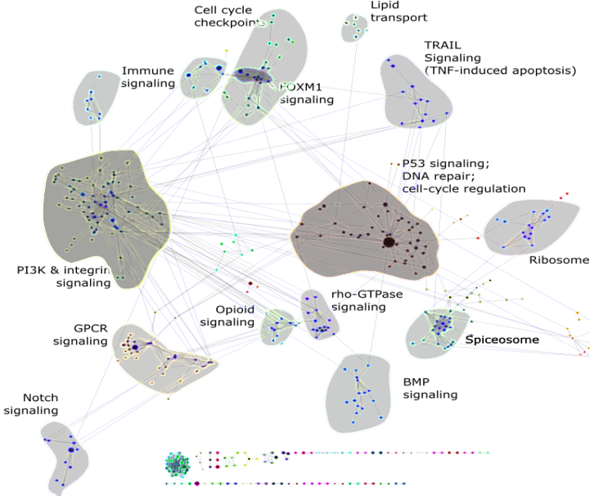
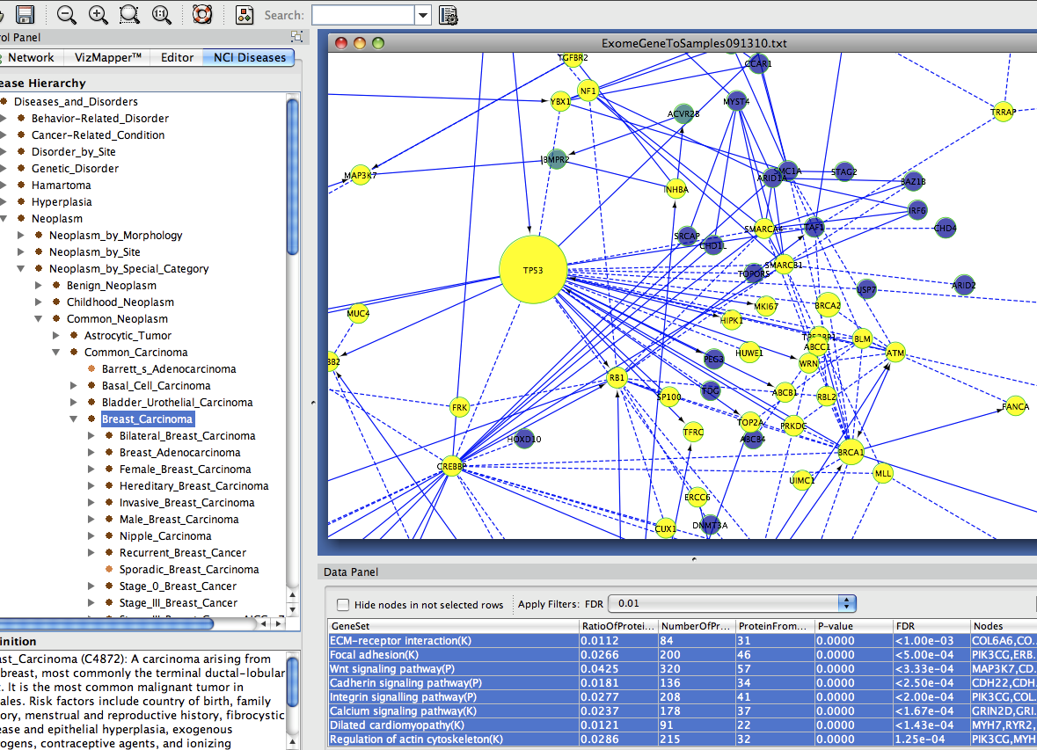
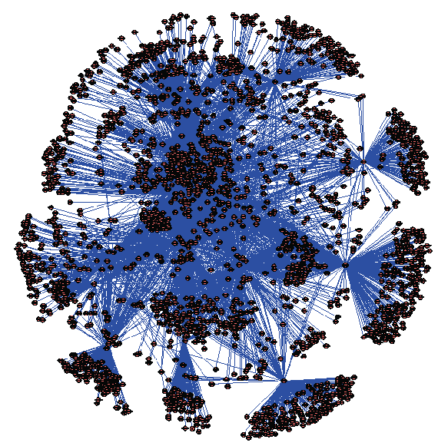
ReactomeFIViz Cytoscape App
+
Machine Learning
Reactome Functional Interaction Network
(~12K proteins; ~328K interactions)
Curated
Pathway DBs
Uncurated
Interaction
Evidence
+
Project your data into Reactome FI Network
Extract and Cluster, and Annotate Altered Genes
Disease “modules” (10-30)
Cytoscape using ReactomeFIViz app
A human functional protein interaction network and its application to cancer data analysis, Wu et al. 2010 Genome Biology
Notes:
The Reactome Functional Interaction (FI) Network is a reliable human interaction network based on manually curated pathways extended with verified interactions (328K+ interactions, 12K proteins).
The ReactomeFIViz app allows you to use this pre-existing network to construct a FI sub-network based on a set of genes.
Identify network modules of highly-interacting groups of genes.
Perform functional enrichment analysis to annotate the modules.
Overlay with a variety of information sources such as cancer gene annotations.
When the relevant clinical data is available, you can perform survival analysis to identify prognostic molecular signatures.

Slide 17
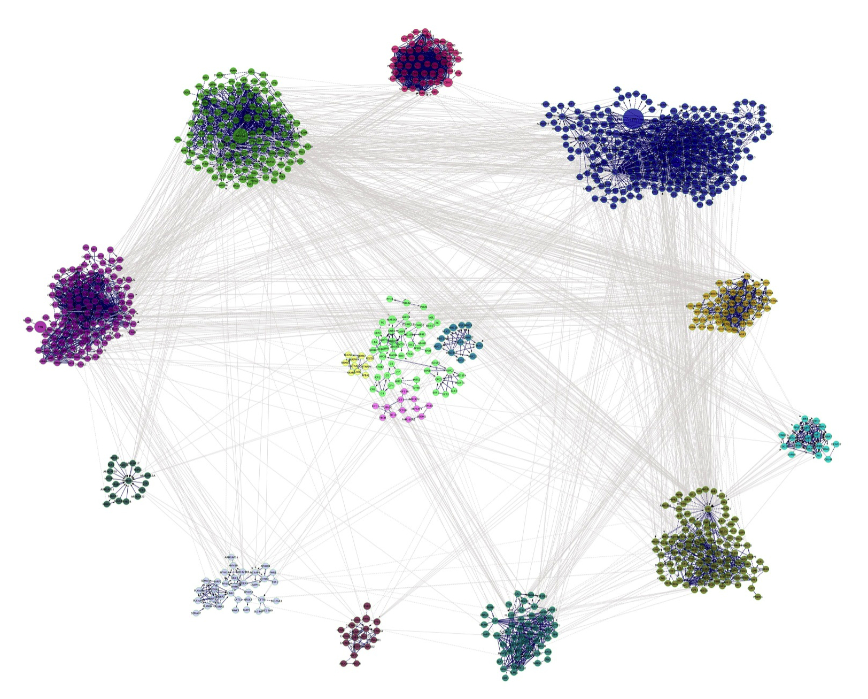
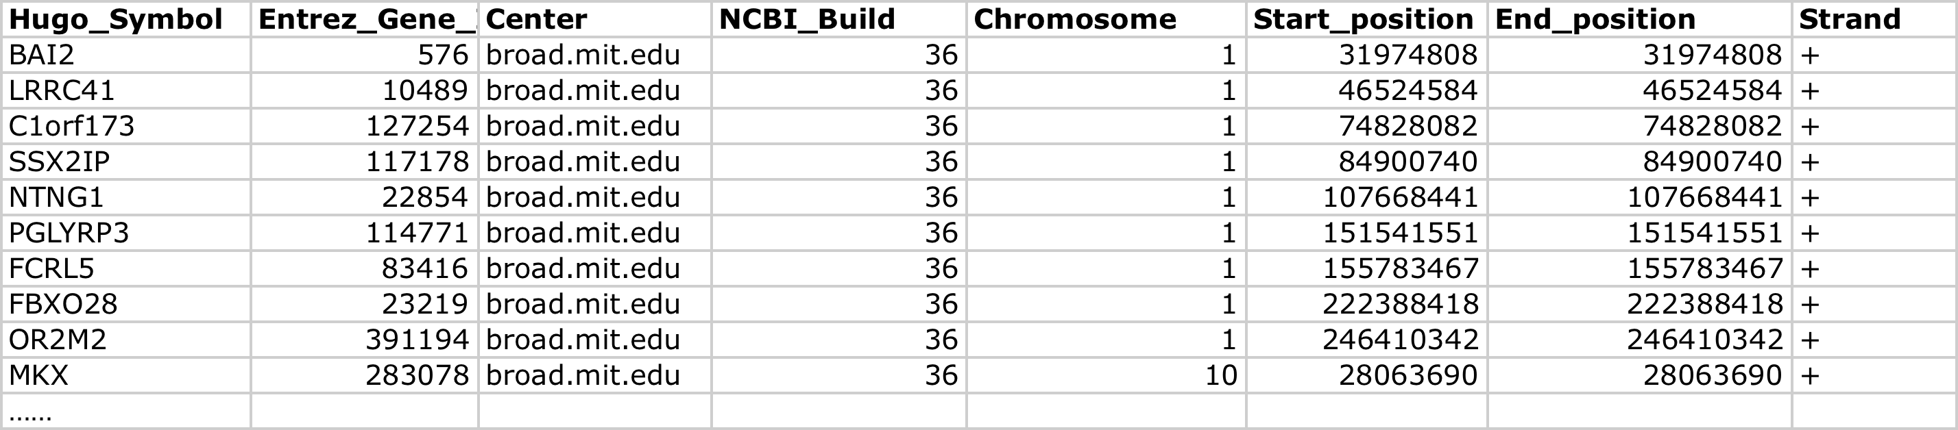
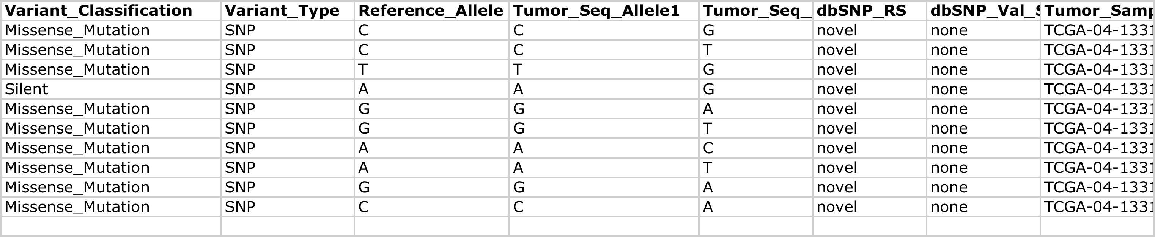
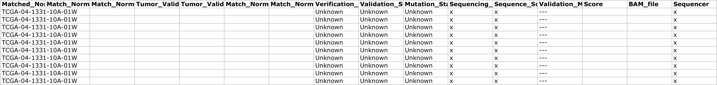
ReactomeFIViz Analysis
Signaling by Tyrosine
Kinase receptors
Cadherin signaling
NOTCH and Wnt signaling
Focal adhesion
ECM-Receptor interaction
Neuroactive ligand-receptor
interaction
Mucin cluster
Cell adhesion
molecules
Ubiquitin-mediated
proteolysis
Metabolism of proteins
Signaling by Rho GTPases
TCGA Breast Cancer Mutations
[NCI MAF (mutation annotation file)]
DNA repair
Cell cycle
Axon guidance
M phase
G2/M Transition
Calcium signaling
Clustering and Annotating of TCGA Breast Cancer Mutations
Notes:
As an example, you could analyze 10000s of variants identified across 10000s of tissue samples from Breast Cancer patients. Using data derived form the Cancer Genome Atlas project, you can cluster and annotate these genes and reduce the complexity of a million data points within a dataset to a handful of mutated pathways to generate a hypothesis to be validated experimentally in the lab.

Slide 18
Conclusions
Reactome is a highly reliable, curated database of biological pathways.
Web site provides tools and datasets for visualizing pathway data and interpreting your experimental data.
ReactomeFIViz app provides a powerful way to visualize and analyze cancer and disease data sets.
All data and software are open to public; no licensing required.

Slide 19
Acknowledgements
Eric Dawson
Antonio Fabregat Mundo
Phani Garapati
Marc Gillespie
Bijay Jassal
Steve Jupe
Bruce May
Lisa Matthews
Marija Orlic-Milacic
Karen Rothfels
Veronica Shamovsky
Konstantinos Sidiropoulos
Guilherme Viteri
Joel Weiser
Marissa Webber
Guanming Wu
Henning Hermjakob
Peter D’Eustachio
Lincoln Stein
Notes:
Reactome is a collaboration between students, curators and developers located at OICR, NYUMC, and EBI.

